Slide 1
Advanced Academic Reading and Discussion
Fall 2012

Slide 2
Attendance
Please raise
your hand
and say
“HERE!”

Slide 4
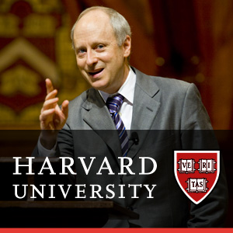

Slide 5
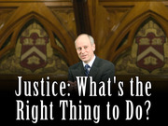
Lecture 1: The Moral Side of Murder
Professor Michael Sandel

Slide 6
Scenario 1
Suppose you’re the driver of a trolley car. You are going 60mph, but you can’t stop because the brakes don’t work. At the end of the track, there are five workers working on the track. You notice that there is a side track on the right side with one worker working on the track. Your steering wheel works. What’s the right thing to do? Keep going straight and kill the five workers, or turn onto the side track and kill only the one worker?

Slide 7
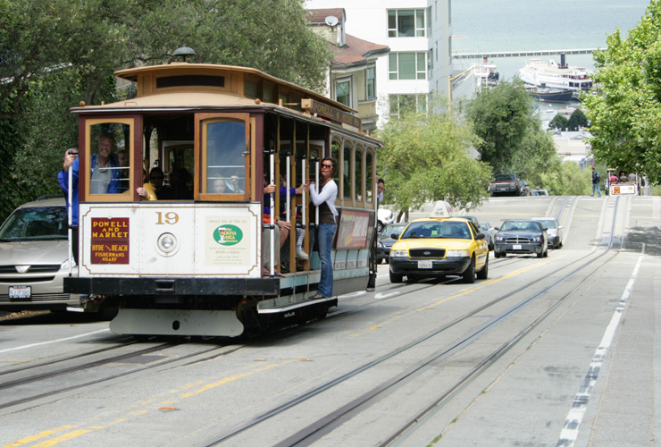
trolley car

Slide 8
Scenario 2
This time, you’re not the driver of the trolley car. You’re an onlooker. You’re standing on a bridge overlooking the trolley car track. A trolley car is coming, and the brakes are not working. There are five workers working at the end of the track. A fat man is standing next to you on the bridge. What’s the right thing to do? Would you push the fat man over the bridge so that he fell on the track, thus saving the lives of the five workers?

Slide 9
Scenario 3
This time, you’re a doctor working in an emergency room. Six patients who have been in a car accident come to the emergency room. Five of them have moderate injuries, and the sixth person has a life-threatening injury. If you care for the five patients, the sixth patient will die. However, if you care for the one severely injured patient, the other five patients will die. What’s the right thing to do? If you were the doctor, would you save the five moderately injured patients or the one severely injured patient?

Slide 10
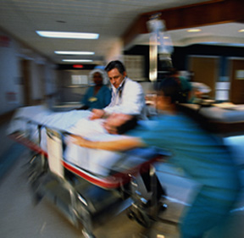
emergency room

Slide 11
Scenario 4
This time, you’re an organ transplant surgeon. You have five patients who are in desperate need of an organ transplant in order to survive. In the next room, there is a healthy man who came to the hospital for a checkup. He is taking a nap. What’s the right thing to do? If you were the doctor, would you steal the healthy man’s organ in order to save the five patients?

Slide 12
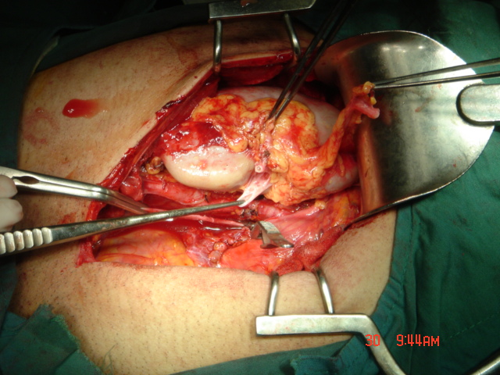
organ transplant surgery

Slide 13
Lecture Questions
What are the two moral principles that Professor Sandel talks about?
Which famous philosophers invented these two types of moral reasoning?

Slide 14
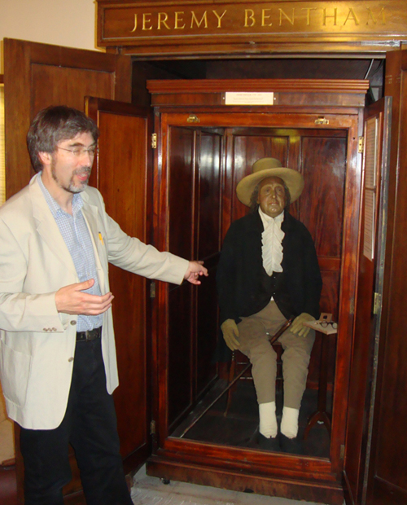
Jeremy Bentham (1748-1832)

Slide 15
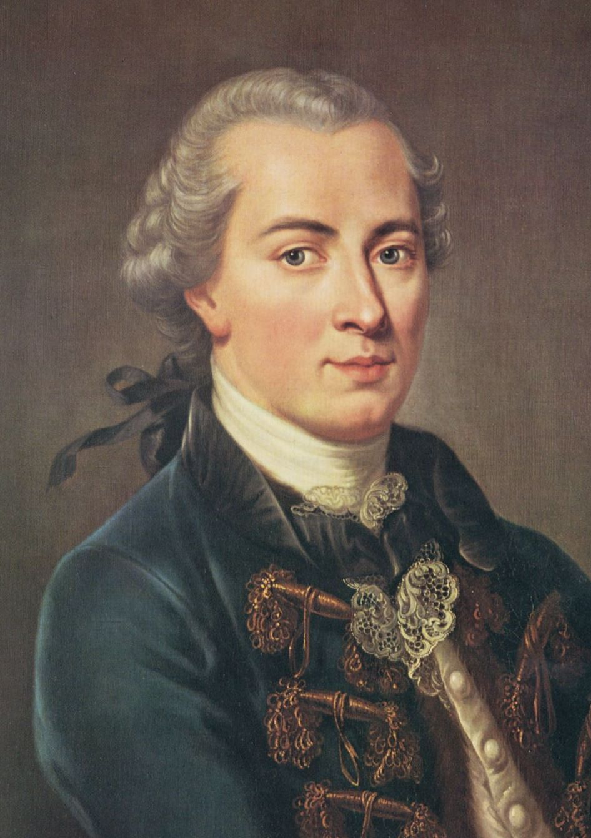
Immanuel Kant (1724-1804)

Slide 16
Do you want to take
a Harvard course for FREE?

Slide 17
Homework
Read Unit 12: Cyber Crime and do the following:
1) Become familiar with the vocabulary words and expressions used in the article.
2) Think about how you would answer the discussion questions on page 48.

Slide 18
Have a fantastic Chuseok! See you on Monday, October 8!

